Slide 1

EIOM
Emergency Information on Mobile

Slide 2
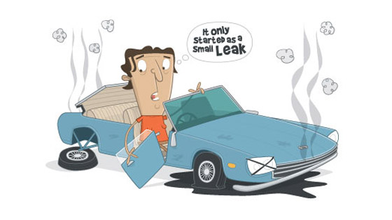
Emergency Information on Mobile
Application on a mobile device
Run on Android OS
Provides the contact information or phone numbers of the nearest help place
Provides a map
Offline mode in case of lost internet connection
○collects name, contract number, address
○update collected data automatically

Slide 3
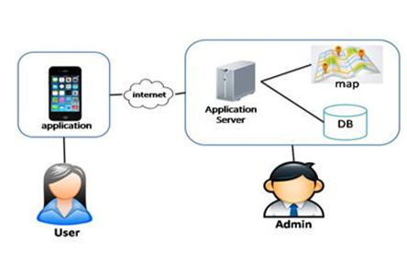
Two parts
●Mobile part for the user
●Server part for the admin
●The user uses the application
and internet to connect with the application server
●The admin manages the the help data
and updates the data to the application server

Slide 4
Server Part
Feature 5: Manage Information System
Feature 6: Support mobile application
Emergency Information on Mobile

Slide 5
URS & SRS
User Requirement Specification : consist of 4 URS
System Requirement Specification: consist of 8 SRS

Slide 6
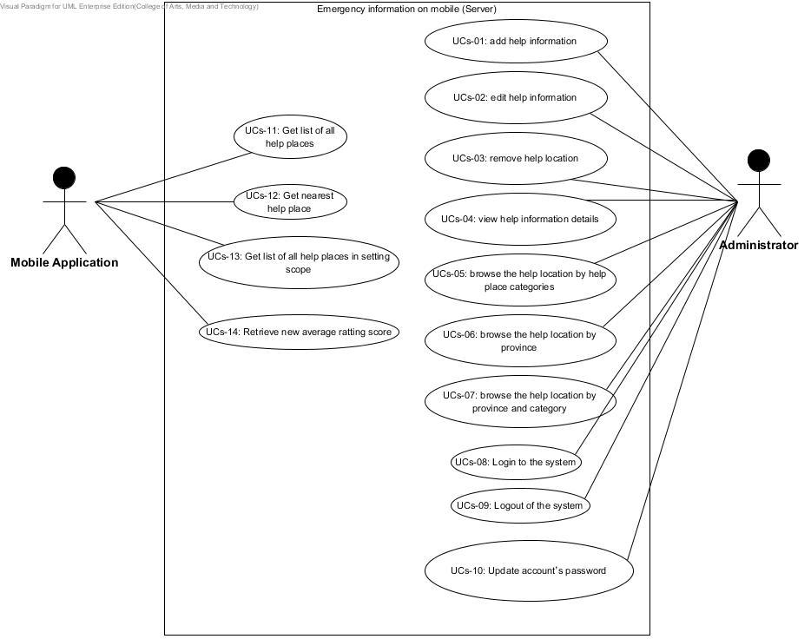
Use Case Diagram

Slide 7
User Requirement Specification
URSs-14: The mobile application can retrieve the help place with new average rating score.
SRSs-55: The system calculates a new average rating score from the new rating score that the mobile application requested.
SRSs-56: The system updates a new average rating score into the system database.
SRSs-57: The system shows help place with new average rating score in form of JSON.

Slide 8
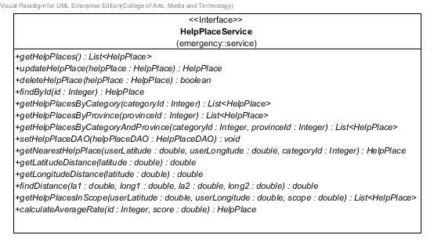
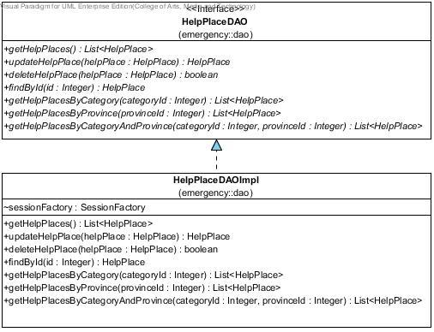
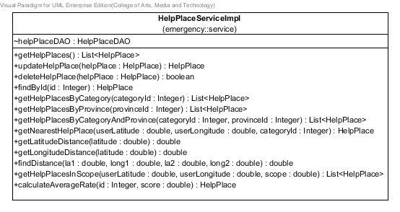
Class Diagram

Slide 9
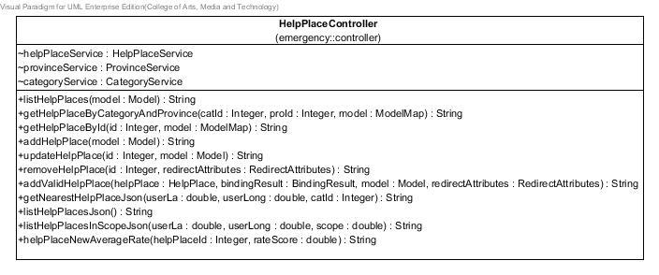
Class Diagram

Slide 10
Method Description
MDs-76: helpPlaceNewAverageRate
public @ResponseBody String helpPlaceNewAverageRate(@PathVariable("helpplaceId") Integer helpPlaceId,@PathVariable("rateScore") double rateScore) throws JSONException
Description: Get help place with new average rating score in JSON form.
Parameter: helpPlaceId - Integer use for get help place.
rateScore -double use for calculate new average rating score.
Return: Information of help place with new average rating score in form of Json.

Slide 11
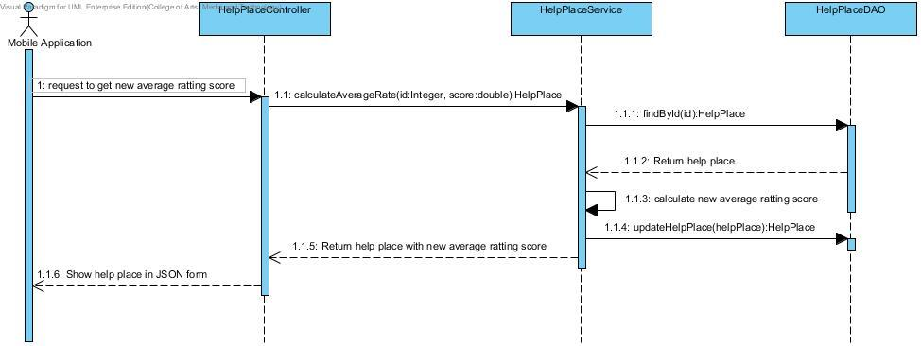
Sequence Diagram

Slide 12
Unit Test Case
Unit Test Case Server 17 (UTCs-17): calculateAverageRate(Integer id, double score):HelpPlace
Case | Description | Input |  | Expected Result
 |  | Help place’s ID | Rating score | New average rating score (double)
1 | Test calculate new help place’s average rating score. | 1 | 2 | 3.5
2 | Test calculate new help place’s average rating score. | 2 | 4.5 | 3.25

Slide 13
Test Record
Unit Test Case Server 17 (UTCs-17): calculateAverageRate(Integer id, double score):HelpPlace
Case | Description | Expected Result | Actual Result | Pass/Fail
 |  | New average rating score (double) | New average rating score (double)
1 | Test calculates new help place’s average rating score. | 3.5 | 3.5 | Pass
2 | Test calculates new help place’s average rating score. | 3.25 | 3.25 | Pass

Slide 14
System Test Case
System Test Case server 14 (STCs-14): The mobile application can retrieve the help place with new average rating score.
Case | Description | Expected Result
1 | Test get help place of ID= 1 and give rating score = 2 | {"HelpplaceNewAverageRate":[{"id":1,"averageRate":3.5,"category":"Hospital","phoneNumber":"053-947700","address":"110 Suthep Rd, Mueang Chiang Mai, Chiang Mai, 50200","name":"Maharaj Nakorn Chiang Mai Hospital","longitude":98.974209,"latitude":18.789602}]}

Slide 15
Test Record
System Test Case server 14 (STCs-14): The mobile application can retrieve the help place with new average rating score.
Case | Description | Expected Result
1 | Test get help place of ID= 1 and give rating score = 2 | {"HelpplaceNewAverageRate":[{"id":1,"averageRate":3.5,"category":"Hospital","phoneNumber":"053-947700","address":"110 Suthep Rd, Mueang Chiang Mai, Chiang Mai, 50200","name":"Maharaj Nakorn Chiang Mai Hospital","longitude":98.974209,"latitude":18.789602}]}
Actual Result | Pass/Fail
{"HelpplaceNewAverageRate":[{"id":1,"averageRate":3.5,"category":"Hospital","phoneNumber":"053-947700","address":"110 Suthep Rd, Mueang Chiang Mai, Chiang Mai, 50200","name":"Maharaj Nakorn Chiang Mai Hospital","longitude":98.974209,"latitude":18.789602}]} | Pass

Slide 16
User Interface
Server Part

Slide 17
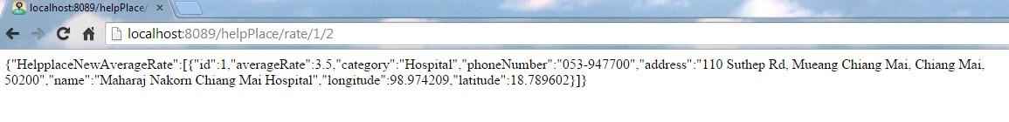
JSON

Slide 18
Mobile Part
Feature 1: Map and help information system
Feature 3: Rating location

Slide 19
URS & SRS
Feature 1: Map and help information system
consist of 2 URS, consist of 7 SRS
Feature 3: Rating location
consist of 3 URS, consist of 7 SRS

Slide 20
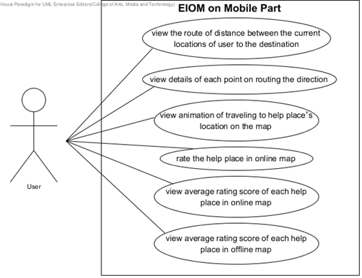
Use Case Diagram

Slide 21
User Requirement Specification
URSm-14: The user can view details of each point on routing the direction.
SRSm-41: The system shall provide Map UI for showing route distance.
SRSm-42: The system shall provide UI for viewing the details.
SRSm-44: The system shall retrieve information file from XML file of Google direction API.
SRSm-45: The system provides UI to show details of distances, which are distance of each point on the map, time to use for driving to each point, average time and the average point.

Slide 22
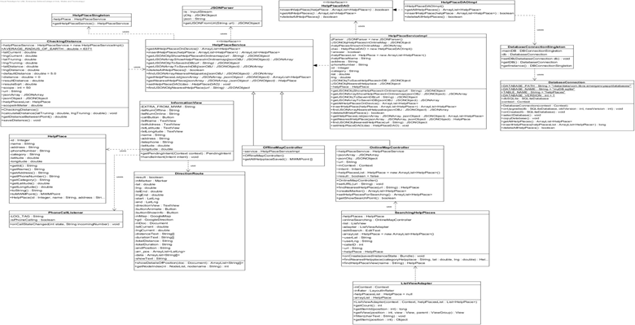
Class Diagram

Slide 23
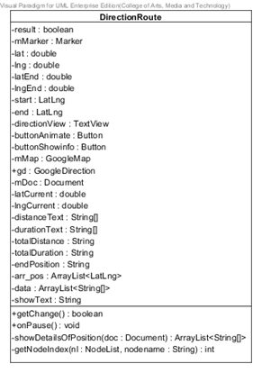
Class Diagram

Slide 24
Method Description
MDm-52: showDetailsOfPosition
public ArrayList<String[]> showDetailsOfPosition(Document doc)
Description: Get information from document for defining data of each node. Includes, maneuver, duration and distance
Parameters: doc - Document uses define document to use
Flow:
1. Set node list to equal doc.getElementsByTagName("step")
2. Use for loop to get item from node list
3. Checking in for loop by using “if statement” to fine keyword “maneuver”
4. If found “maneuver” next node will getIndex and set value of “duration”, “distance” and “maneuver”
5. Adding data into array list
Return: Array list of string array, if invalid input returns null.

Slide 25
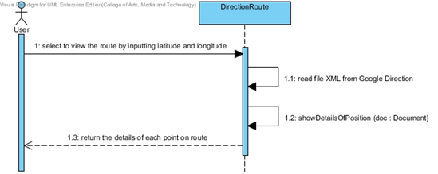
Sequence Diagram

Slide 26
System Test Case
System Test Case mobile 05 (STCm-05): User can view help information of each help place in online map
Test Script:
1. User enters to the application with the device that has an internet connection.
2. User inputs their current latitude and longitude, such as, 98.974209 and 18.789602.
3. User selects marker of “Lanna Hospital”.
4. User clicks to view information.
Case | Description | Expected Result
1 | Test view information of “Lanna Hospital” help place | System shows information of “Lanna Hospital”. Name as “Lanna Hospital” Phone Number as “053-999758” Address as “Chang Phuak, Mueang Chiang Mai, Chiang Mai, 50300” Latitude as “98.991151” Longitude as “18.812723” Rating score as “5”

Slide 27
System Test Record
System Test Case Mobile 05 (STCm-05): User can view help information of each help place in online map
Test Date: 9/12/2014
Test By: Putchakarn Jaikon
Case | Expected Result | Actual Result | Pass/Fail
1 | System shows information of “Lanna Hospital”. Name as “Lanna Hospital” Phone Number as “053-999758” Address as “Chang Phuak, Mueang Chiang Mai, Chiang Mai, 50300” Latitude as “98.991151” Longitude as “18.812723” Rating score as “5” | System shows information of “Lanna Hospital”. Name as “Lanna Hospital” Phone Number as “053-999758” Address as “Chang Phuak, Mueang Chiang Mai, Chiang Mai, 50300” Latitude as “98.991151” Longitude as “18.812723” Rating score as “5” | Pass

Slide 28
User Interface
Mobile Part

Slide 29
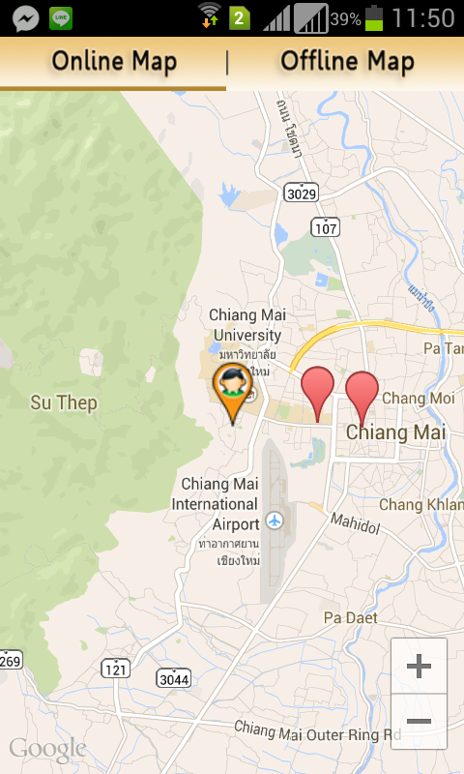
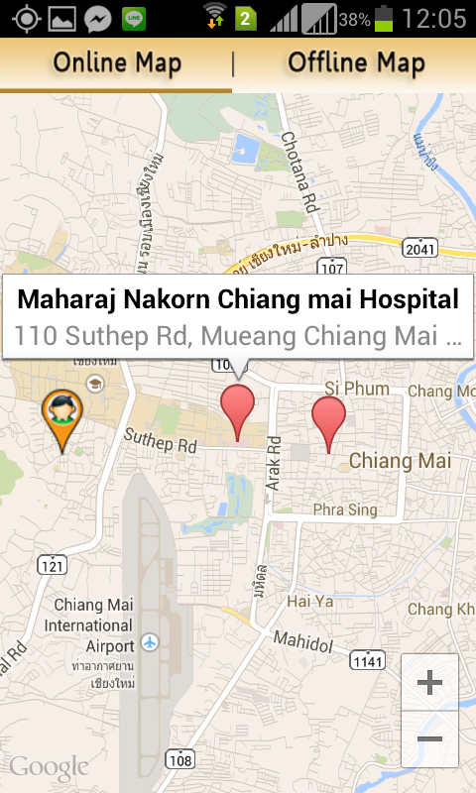
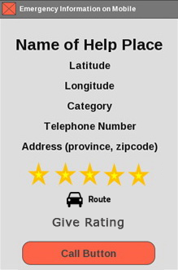
Show Online Map

Slide 30
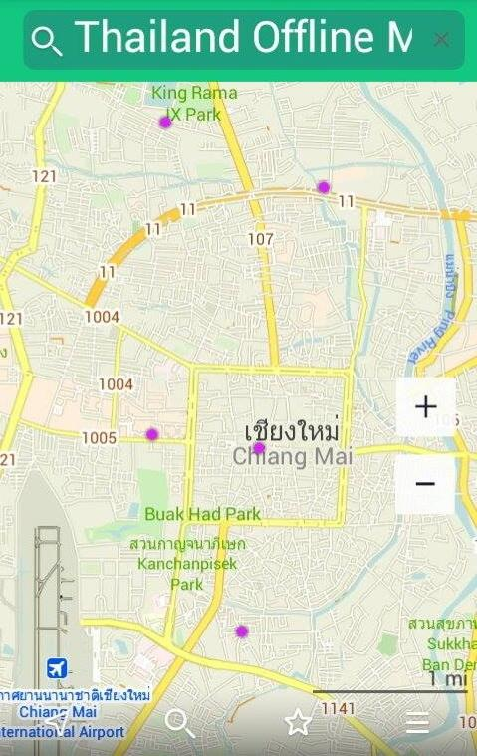
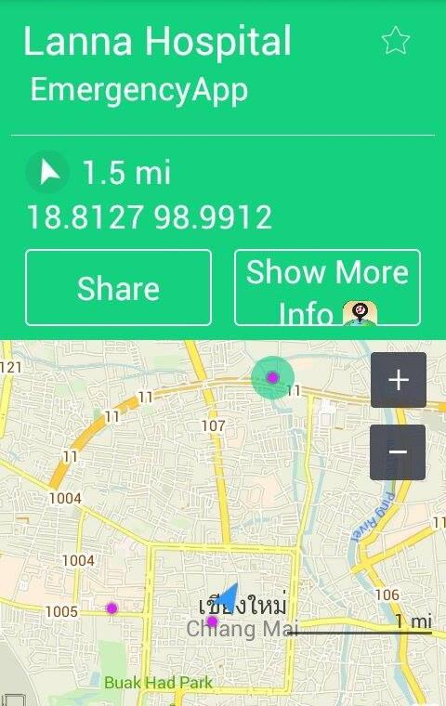
Show Offline Map

Slide 31
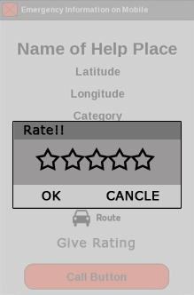
Rating Help place

Slide 32
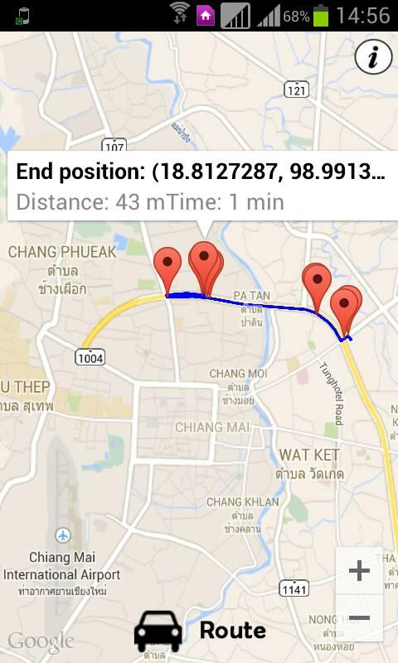
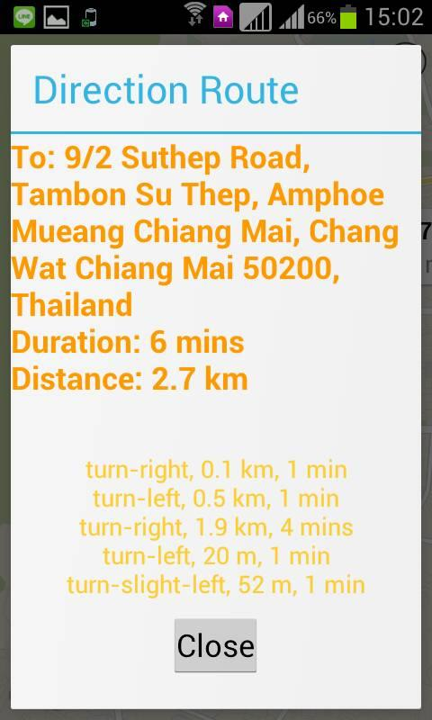
Show Route Distance

Slide 33
Problem & Solution
Summarization
• Working as a team
• Daring to share the opinion with teammate more
• Acquire knowledge in various fields of work, such as, test, develop, design, improve work
• The tasks can fulfilled which the plan of project
• Problem
- Waste much time to test the system.
• Solution
- Manage time table by using the test plan

Slide 34
DEMO PROGRAM
Emergency Information on Mobile

Slide 35
Q/A
Emergency Information on Mobile

